Slide 1

WELCOME
We are very glad you are here

Slide 2

ALGORITHM
VISUALIZER
Software
Web Application

Slide 3

NAME
SECTION
ROLL NO.
Biswarup Bhattacharjee
I
17
Subhajit Pati
C
68
Rahul Debnath
D
38
Arijit Goswami
E
11
Subhadip Maji
I
67
Ankita Sikder
I
8

Slide 4

Introduction
This is a web application which is used to visualise algorithms. It has been created using JavaScript, CSS, SCSS, ReactJS, HTML5, Vercel, Firebase, Chat Engine XDK, nodejs and Formik. User can approach this website through a provided link. First of all it has a sign up or login page. If user is opening it for first time he has to select sign up option. Here he has to give username, email id, password, verify password. If he has already signed up, then he has to go to login option and then he has to give email, password, confirm password. Then you have entered in the main page or home page. Here user can see your email id and a firebase-provided password. Here four buttons are given. VISUALIZE ALGORITHMS, ALGORITHMS, DISCUSSION, FEEDBACK. By clicking on VISUALIZE ALGORITHMS user can watch and understand working of some specific algorithms. If user goes to ALGORITHMS he can see total 72 algorithms. Sorting, Searching and Others algorithms. If he clicks any of them in learn more button then their details will be shown in a page. The DISCUSSION part will take the user to a login page where he has to give username and password (firebaseprovided password in home page). Then he will be added in a discussion group for doubt clearing where the developers will answer his questions regarding this website. In the feedback portion user can write about how much this website is useful or any idea for improvement in this website in the comment section. In mathematics and computer science, an algorithm is a finite sequence of welldefined, computer-implementable instructions, typically to solve a class of problems or to perform a computation. Algorithms are always unambiguous and are used as specifications for performing calculations, data processing, automated reasoning, and other tasks.

Slide 5

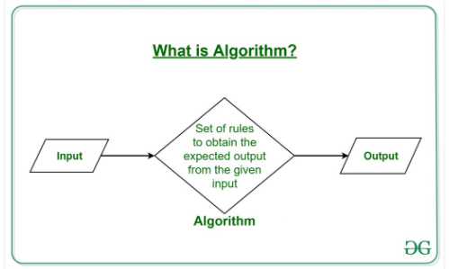
What is Algorithm ?
The word Algorithm means “a process or set of rules to be followed in calculations or other problem-solving operations”. Therefore Algorithm refers to a set of rules/instructions that step-by-step define how a work is to be executed upon in order to get the expected results.

Slide 6

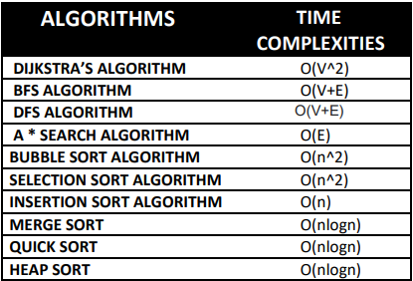
Time Complexity :-
Time complexity is a function describing the amount of time an algorithm takes in terms of the amount of input to the algorithm.

Slide 7


Recurrence Relation :-
A recurrence is an equation or inequality that describes a function in terms of its values on smaller inputs. To solve a Recurrence Relation means to obtain a function defined on the natural numbers that satisfy the recurrence. It is use to calculate Time complexity of an algorithm.
Visualization :-
1: Formation of mental visual images.
2: The act or process of interpreting in visual terms or of putting into visible form.

Slide 8

Algorithm Visualization
In addition to the mathematical and empirical analyses of algorithms, there is yet a third way to study algorithms.
It is called algorithm visualization and can be defined as the use of images to convey some useful information about algorithms.
That information can be a visual illustration of an algorithm’s operation, of its per-formance on different kinds of inputs, or of its execution speed versus that of other algorithms for the same problem. To accomplish this goal, an algorithm visualiza-tion uses graphic elements—points, line segments, two- or three-dimensional bars, and so on—to represent some “interesting events” in the algorithm’s operation.

Slide 9

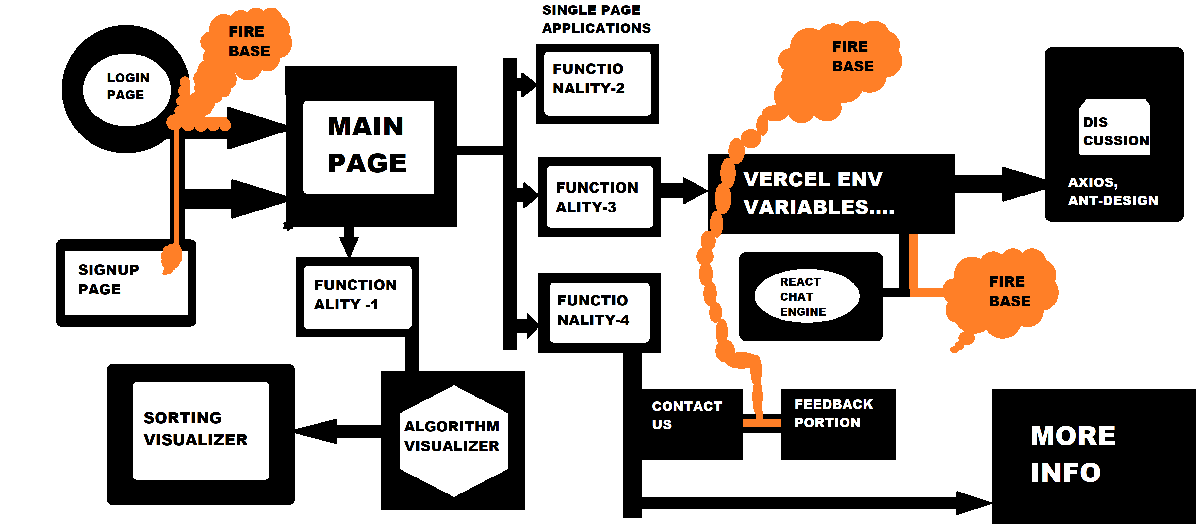
Block Diagram

Slide 10
Working Principal
This is a web application which is used to visualize algorithms.
It has been created using JavaScript, CSS, SCSS, ReactJS, bootstrap, HTML5, Vercel, Firebase, Chat Engine SDK, nodejs and Formik.
Firebase :-
At first we create a project in Firebase then this project set to web application based
Basically firebase is a Backend-as-a-Service (Baas). It provides developers with a variety of tools and services to help them develop quality apps, grow their user base, and earn profit. It is built on Google's infrastructure. . Firebase is categorized as a NoSQL database program, which stores data in JSON-like documents.

Slide 11
Java Script :-
Functions are defined, or declared, with the function keyword. Below is the syntax for a function in JavaScript.
Css :-
CSS is used to define styles for your web pages, including the design, layout and variations in display for different devices and screen sizes.
Sass :-
Sass (which stands for 'Syntactically awesome style sheets) is an extension of CSS that enables you to use things like variables, nested rules, inline imports and more. It also helps to keep things organised and allows you to create style sheets faster. Sass is compatible with all versions of CSS.

Slide 12

Html 5 :-
HTML is a markup language that web browsers use to interpret and compose text, images, and other material into visual or audible web pages.
ReactJS :-
React (also known as React.js or ReactJS) is an open-source, front end, JavaScript library for building user interfaces or UI components. It is maintained by Facebook and a community of individual developers and companies. React can be used as a base in the development of single-page or mobile applications.
Bootstrap :-
Bootstrap is a free and open source front end development framework for the creation of websites and web apps

Slide 13
Vercel :-
Vercel is the best place to deploy any frontend app. Start by deploying with zero configuration to our global edge network. Scale dynamically to millions of pages without breaking a sweat. index.js.
Chatengine SDK:-
Chat Engine is an API which makes it easy to build chat services.Building a chat from scratch takes a lot of time, code, and is expensive.It's better to use a product instead of writing it from scratch.We make it easy to build your chat idea in minutes.
NodeJS :-
Node. js is a platform built on Chrome's JavaScript runtime for easily building fast and scalable network applications. Node. js uses an event-driven, non-blocking I/O model that makes it lightweight and efficient, perfect for data-intensive real-time applications that run across distributed devices.
Formik :-
Formik is the world's most popular open source form library for React and React Native. It is use to create various types of forms like signup, login etc.

Slide 14

Functionality-1
In mathematics and computer science, an algorithm is a finite sequence of well defined, computer-implementable instructions, typically to solve a class of problems or to perform a computation. Algorithms are always unambiguous and are used as specifications for performing calculations, data processing, automated reasoning, and other tasks. As an effective method, an algorithm can be expressed within a finite amount of space and time, and in a well defined formal language for calculating a function. Starting from an initial state and initial input (perhaps empty), the instructions describe a computation that, when executed, proceeds through a finite number of well defined successive states, eventually producing "output" and terminating at a final ending state. Here we can see different type of algorithms and their details.
Searching Visualizer follows path finding approach & Sorting is integrated is searching portion.

Slide 15

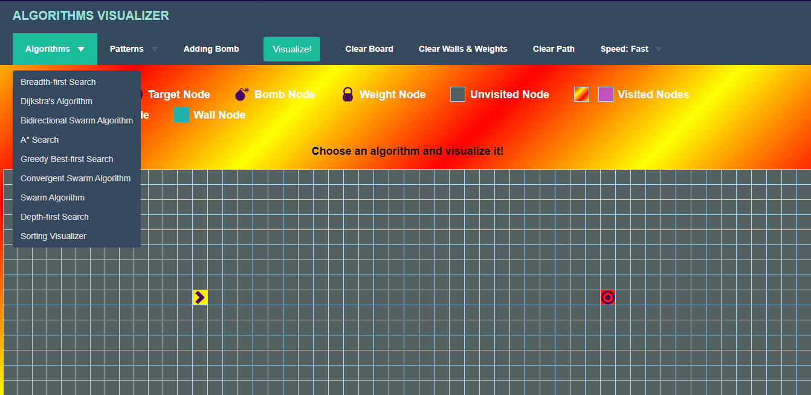
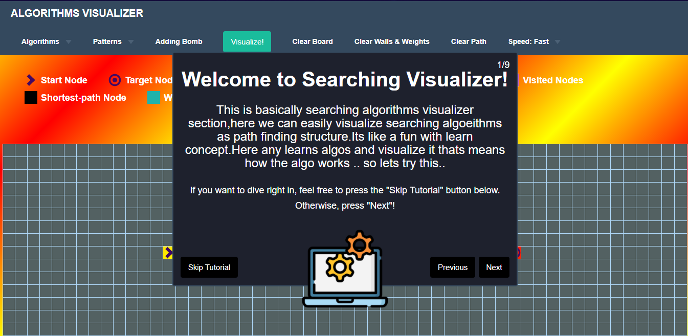
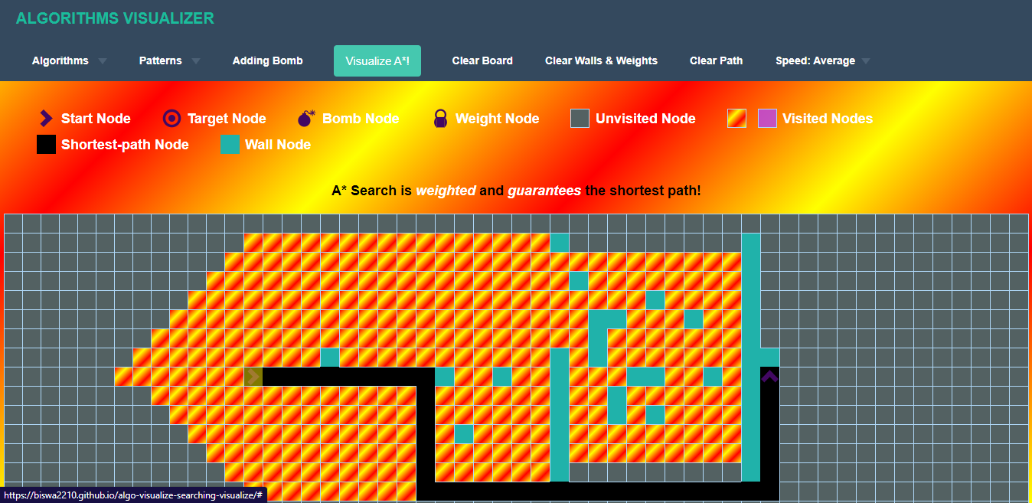
SCREENSHOTS
Searching
Visualizer

Slide 16

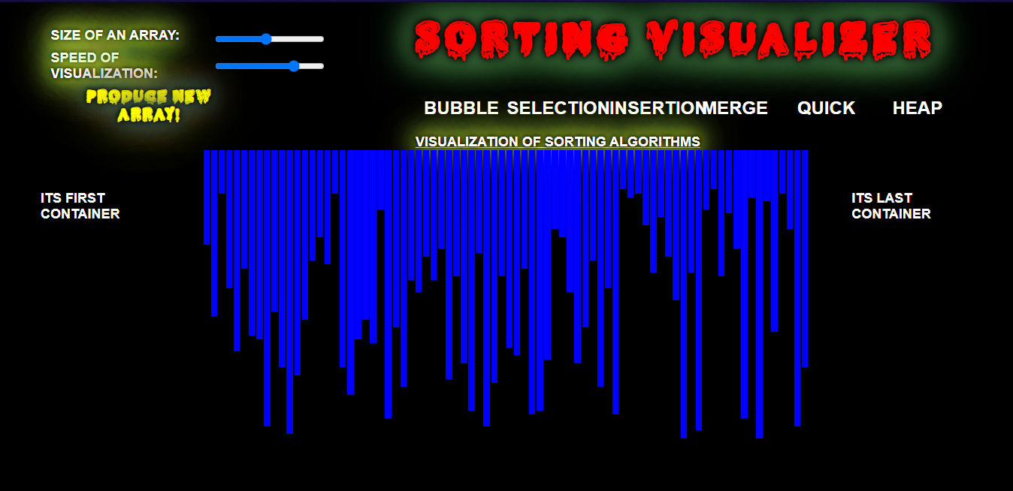
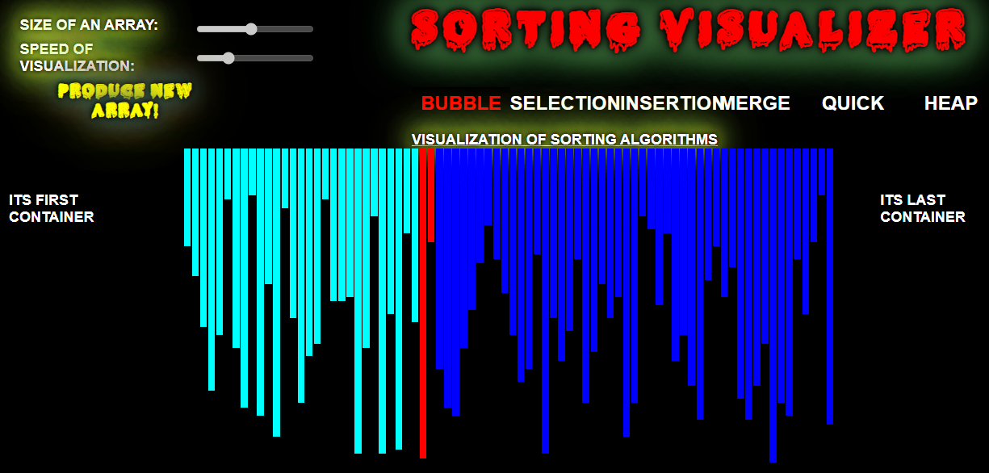
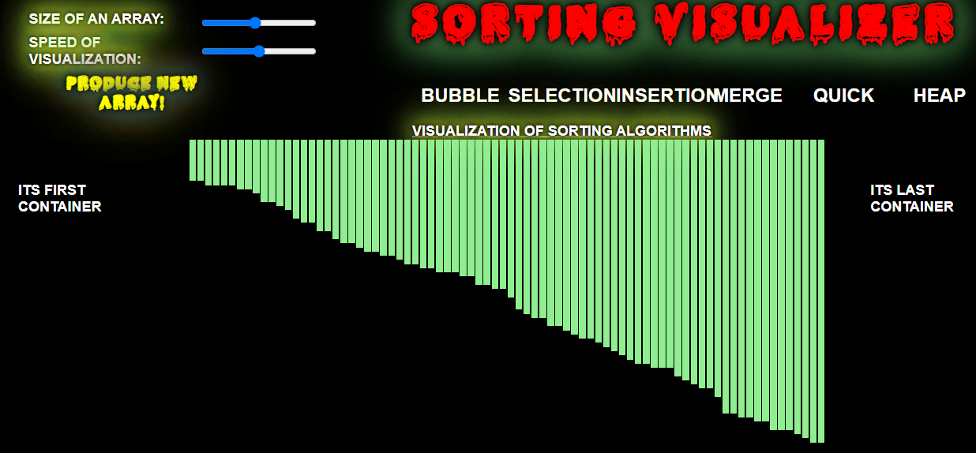
Sorting Visualizer

Slide 17

Functionality-2
In mathematics and computer science, an algorithm is a finite sequence of well defined, computer-implementable instructions, typically to solve a class of problems or to perform a computation. Algorithms are always unambiguous and are used as specifications for performing calculations, data processing, automated reasoning, and other tasks. As an effective method, an algorithm can be expressed within a finite amount of space and time, and in a well defined formal language for calculating a function. Starting from an initial state and initial input (perhaps empty), the instructions describe a computation that, when executed, proceeds through a finite number of well defined successive states, eventually producing "output" and terminating at a final ending state. Here we can see different type of algorithms and their details.

Slide 18


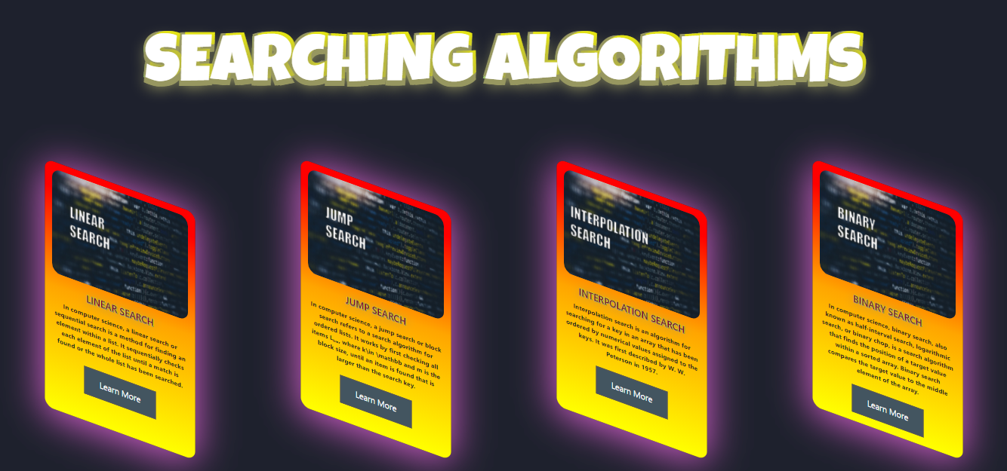
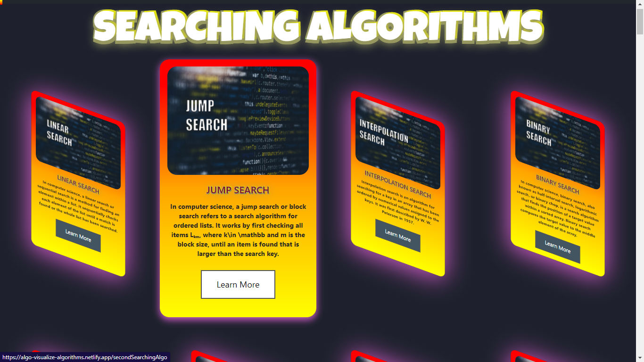
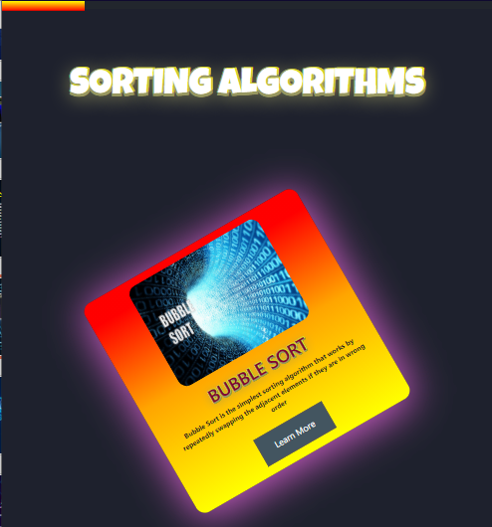
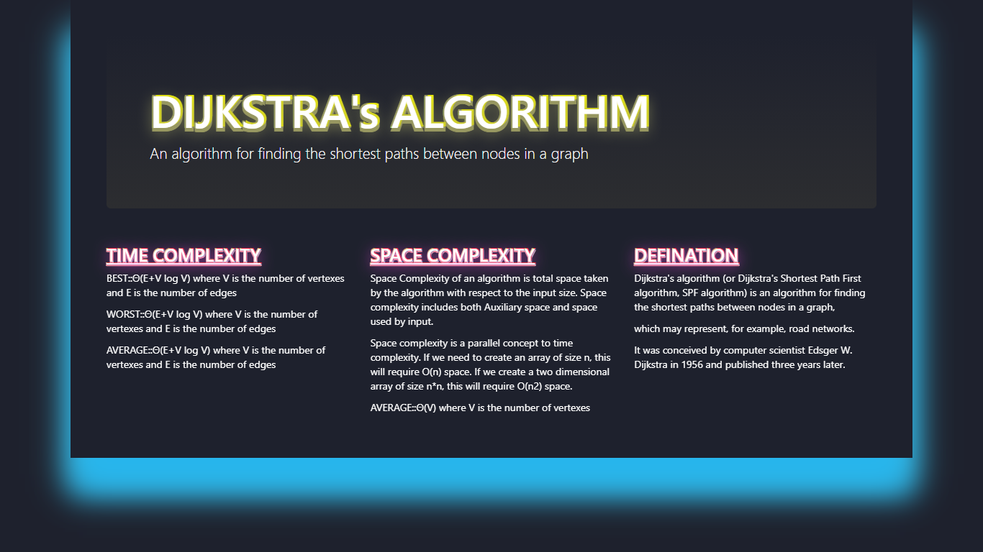
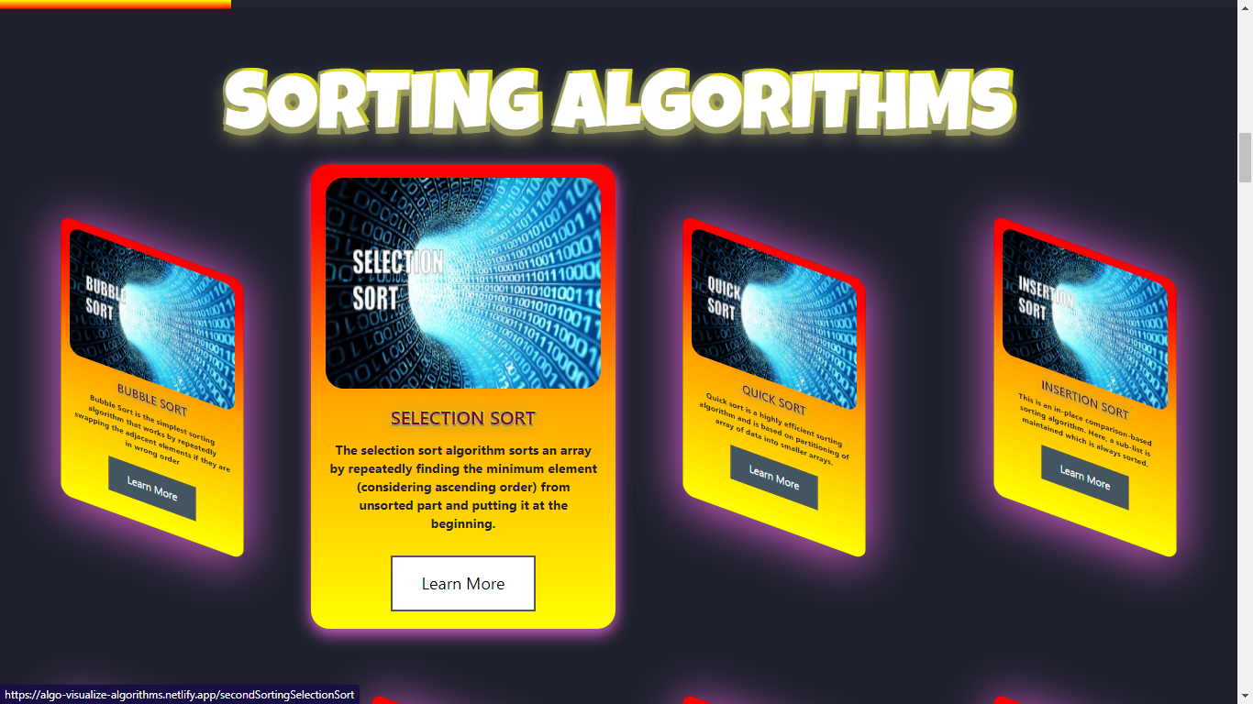
SCREENSHOTS

Slide 19

Functionality-3
The DISCUSSION part will take the user to a login page where he has to give username and password (firebase-provided password in home page). Then he will be added in a discussion group for doubt clearing where the developers will answer his questions regarding this website. Discussion is important for any queries of user. When developers guide the user properly it will very helpful for the user to explore the web site. The purpose of the discussion is to interpret and describe the significance of your findings in light of what was already known about the research problem being investigated and to explain any new understanding or insights that emerged as a result of your study of the problem.

Slide 20


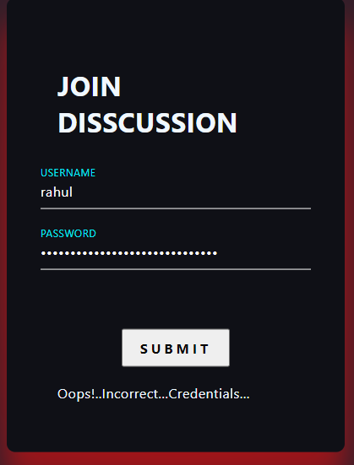
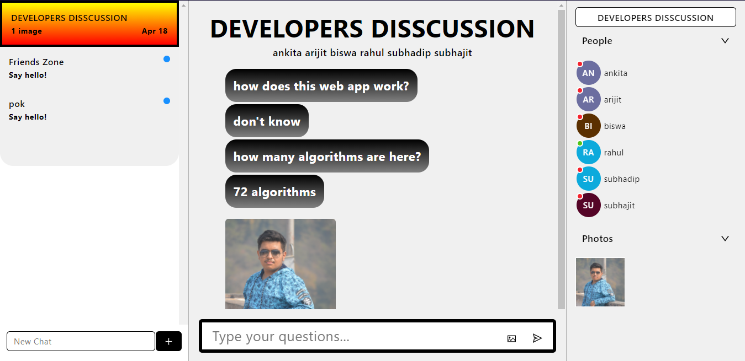
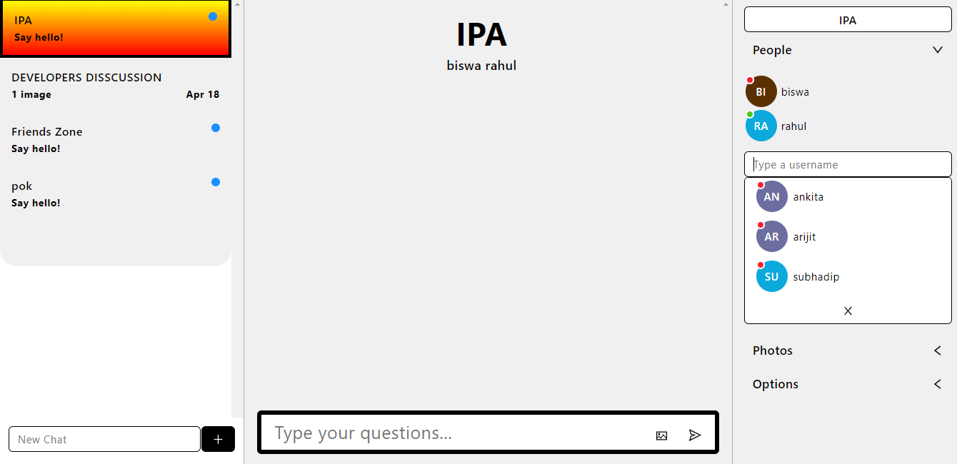
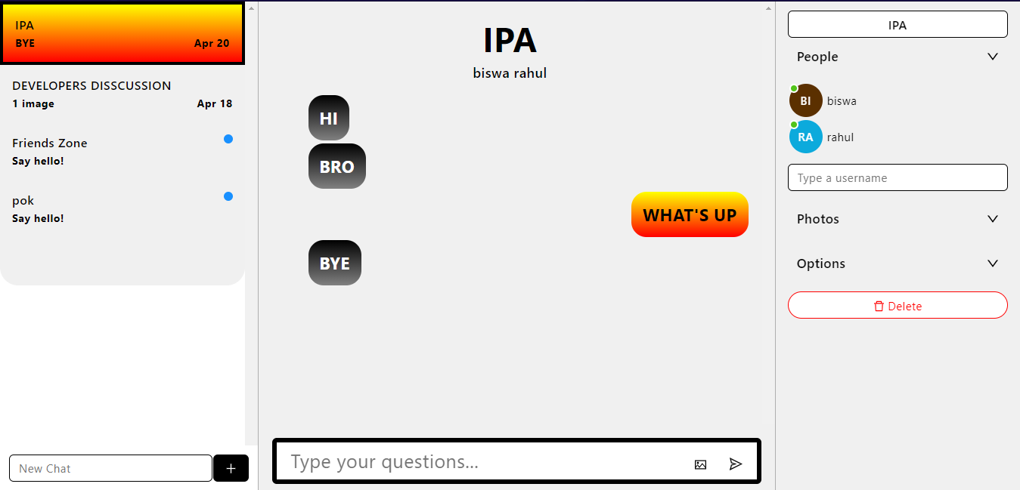
SCREENSHOTS

Slide 21

Functionality-4
Feedback occurs when outputs of a system are routed back as inputs as part of a chain of cause-and-effect that forms a circuit or loop. The system can then be said to feed back into itself. The notion of cause-and-effect has to be handled carefully when applied to feedback systems: Simple causal reasoning about a feedback system is difficult because the first system influences the second and second system influences the first, leading to a circular argument. This makes reasoning based upon cause and effect tricky, and it is necessary to analyze the system as a whole. Website feedback is information obtained directly from website users through on-page surveys, feedback widgets, and other techniques to help organizations understand what people think (and how they feel) about their websites and landing pages.

Slide 22

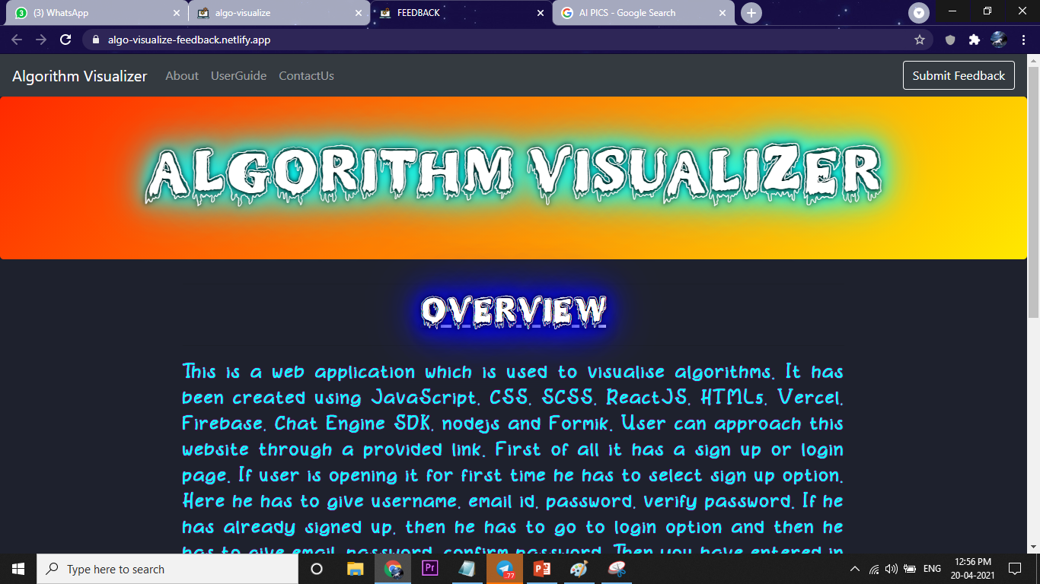
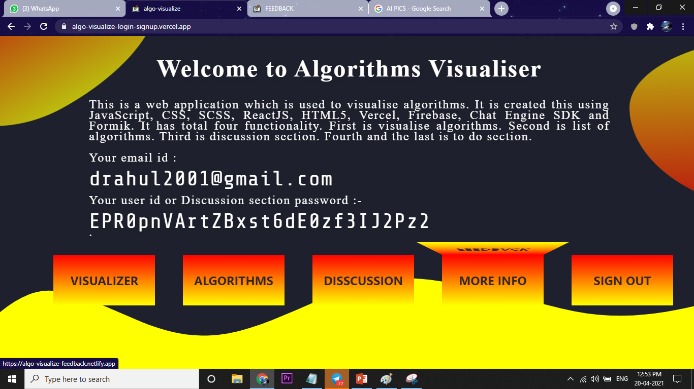
More Info :-
By clicking the More Info we get into the feedback portion. Here you can write in the comment section. You can write about how much this website is useful or any idea for improvement in this website. Go back to main page.Here you can write in the comment section. You can write about how much this website is useful or any idea for improvement in this website. Go back to main page.

Slide 23

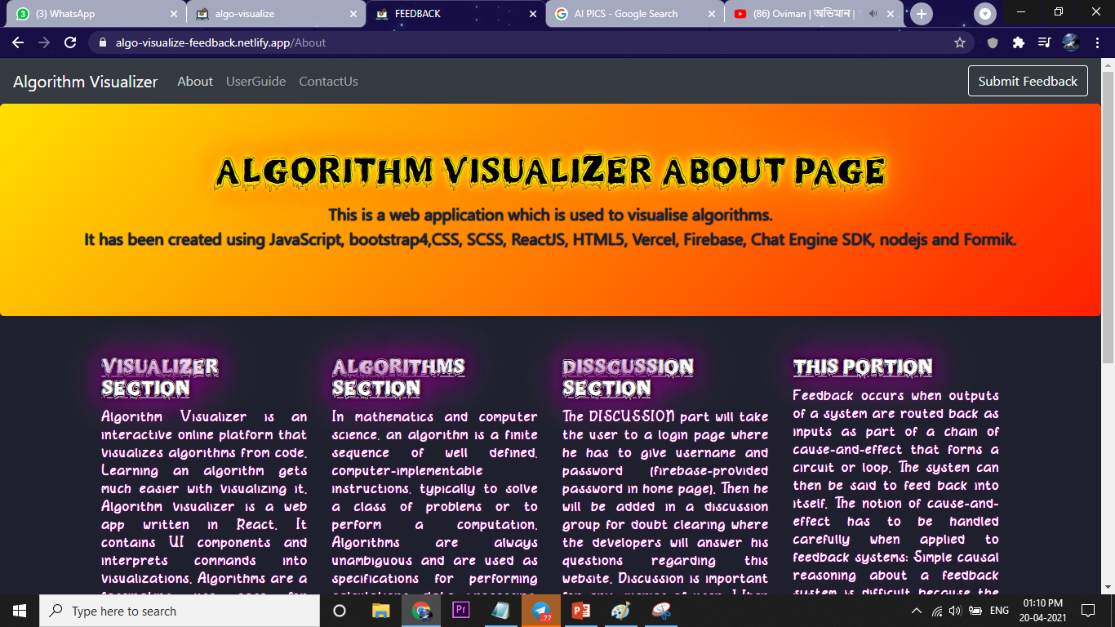
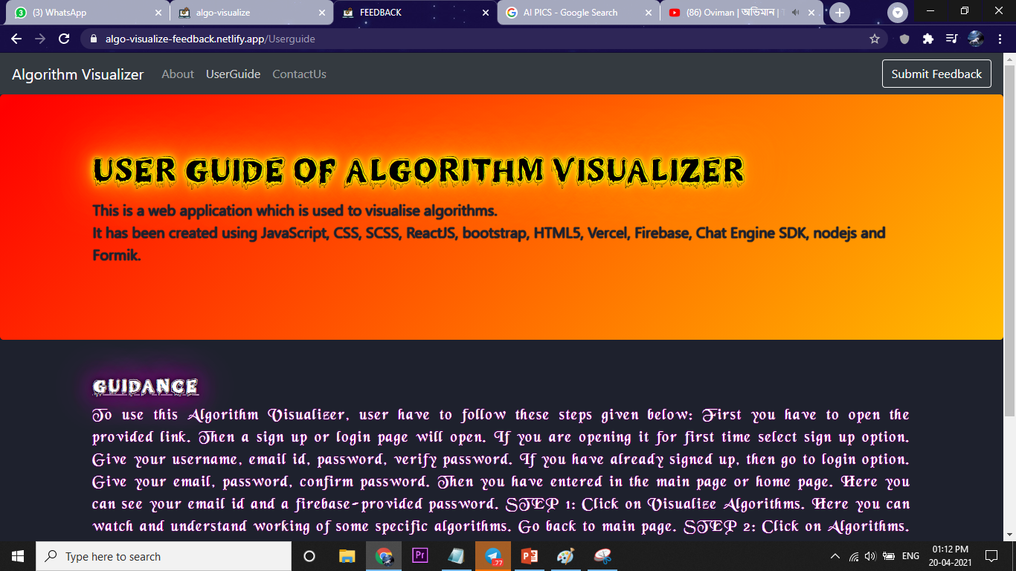
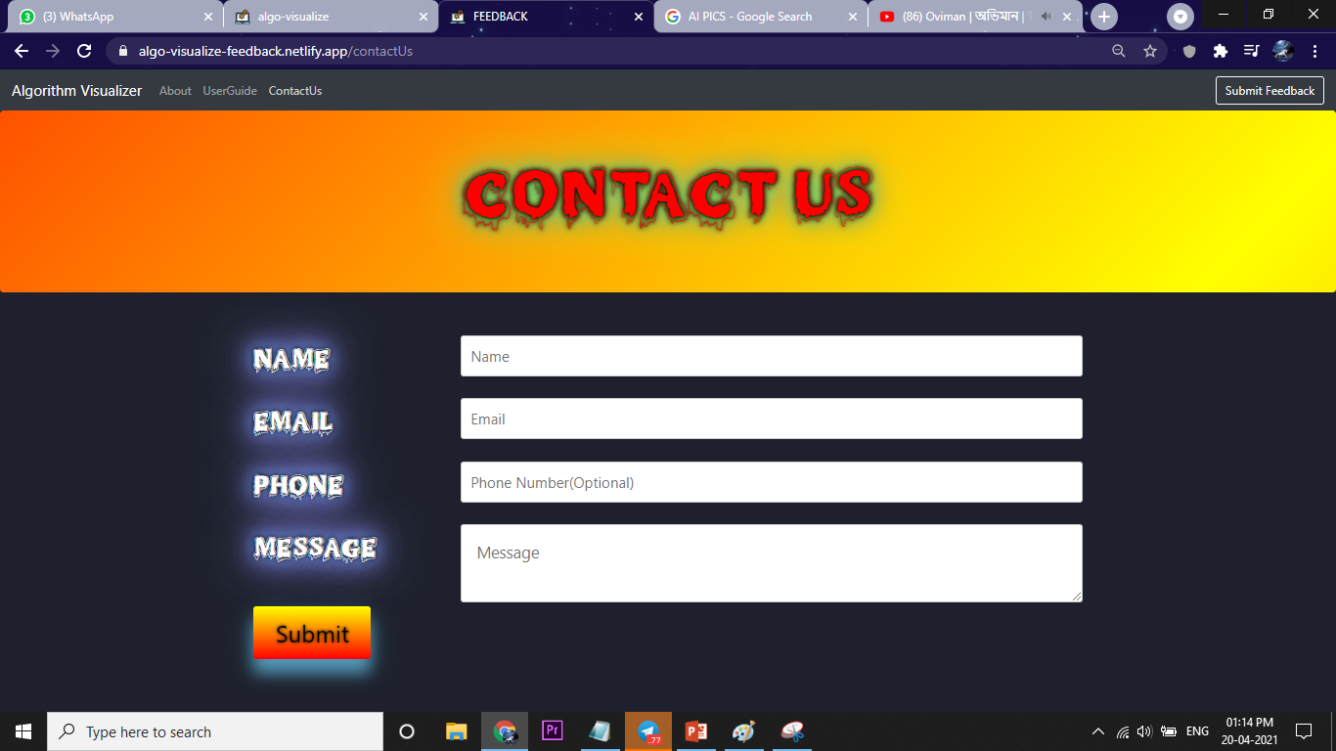
About :-
UserGuide :-
ContactUs :-

Slide 24

What is Feedback?
Feedback is a reaction or information that occurs as a result of actions or behavior undertaken by an individual or group. In a Learning & Development context, both positive and negative feedback is crucial. Feedback provides a sense of engagement and interactivity, and allows learners to take ownership of their learning. Effective feedback shows learners their current level of performance, and lets them know what they need to do to reach a higher level.
Why it is important?
Feedback provides a sense of engagement and interactivity, and allows learners to take ownership of their learning. Effective feedback shows learners their current level of performance, and lets them know what they need to do to reach a higher level.

Slide 25

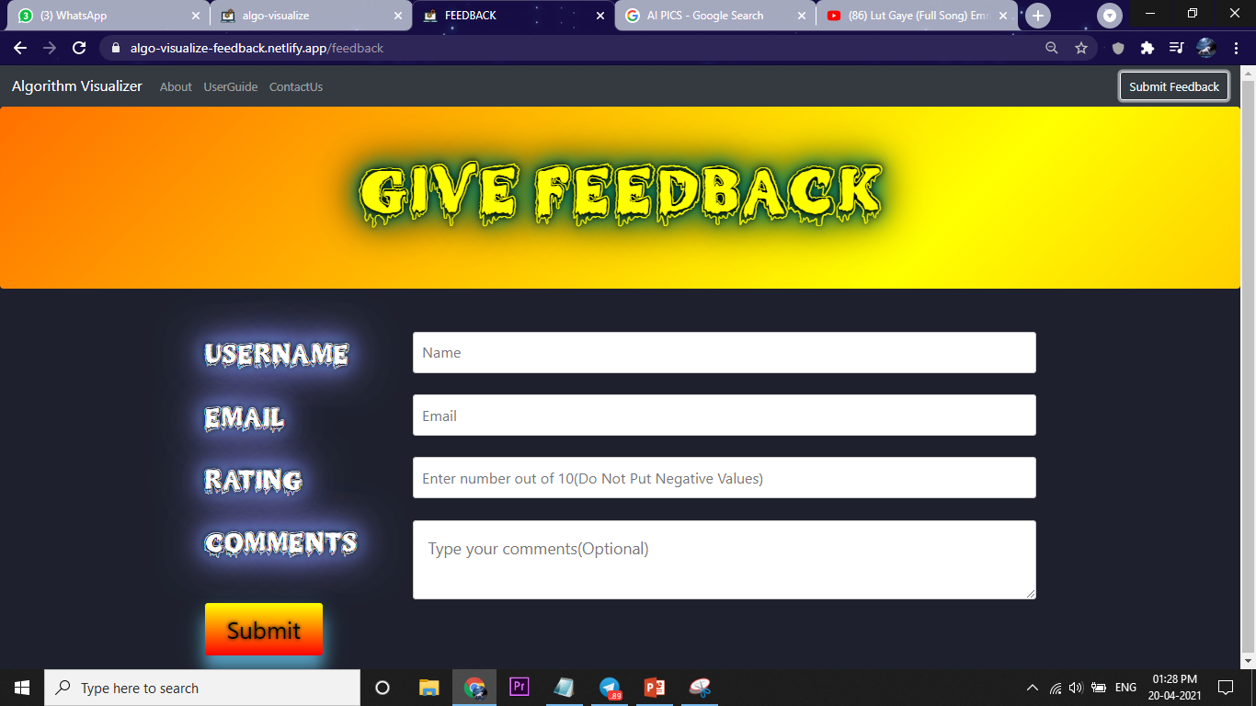
Submit Feedback

Slide 26

Applications
• This web app can be useful for students, interns, office workers or anyone who want to learn algorithms and their working flow. This online interactive platform base study is trending these days.
• Students or any one who want to learn algorithm they can interact with the developers or any other user for any query, related to this web app. This idea of interaction and safe chatting area provides user nice way of learning.
• This web application has a descriptive portion of 72 algorithms which is very useful for students of Computer Science and Mathematics subjects. Here time complexity, space complexity, definition and other information are gathered for students so that they don’t have to search all information in google spending lot of time.

Slide 27

Future Scope
• Students while working on a course have to solve assignments. For solving exercises and finishing assignments students can use this algorithm visualizer
• Students like discussion-based study through an interactive platform. So that they will use it.
• Without searching about algorithms students will get enough information about algorithms. It will save their time.

Slide 28
Conclusion
• Algorithm visualization can be seen as a valuable supporting tool, used in addition to standardways of education in the ﬁeld of computer science.
• it helps to improve the quality of education in the ﬁeld and contribute to the solution for some of theproblems in higher education.
• Algorithm visualizations can help understanding theprinciples, but do not replace the need to implement algorithms by students is a chosen programming language.

Slide 29

Thank You
Deployment Link :- https://algo-visualize-login-signup.vercel.app/

